Slide 1
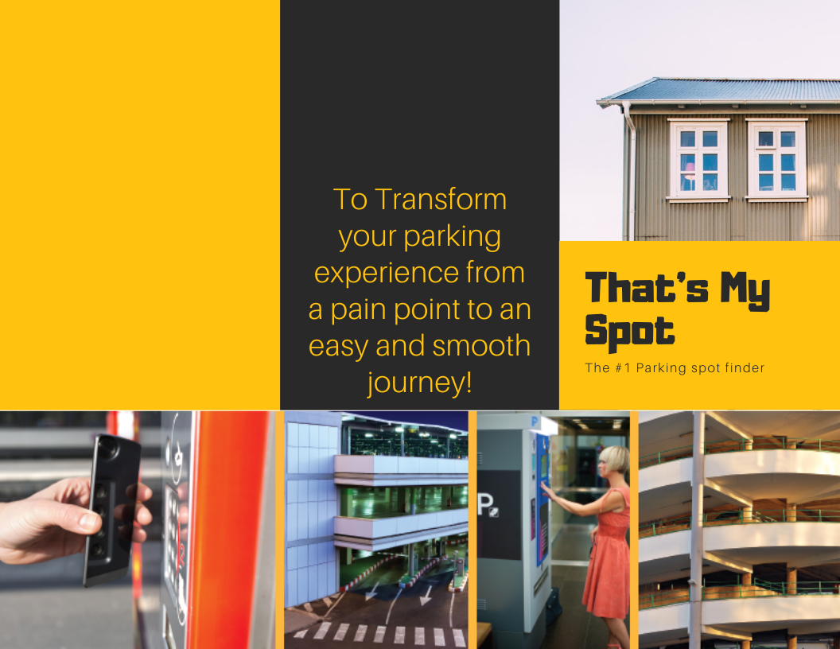
Notes:
Hi prof , this is Shubham and we are team b-13. That’s my spot is a parking app which allows users to find a parking spot at ease.
Every day, millions of people look to park their cars on the street and often spend 5-10 minutes looking for a parking spot in the permitted area.
Apart from time, there can be confusing sign boards which may lead you to park in a wrong spot. That is where the motivation for this project came up from.
That’s my spot aims to provide a solution for this problem by getting the time left on the parking meter to show the person looking for parking if the meter is unpaid and show if any spot will be vacant in a span of 15 minutes. Using the app, users can also book a spot in a parking garage prior to their arrival.

Slide 2
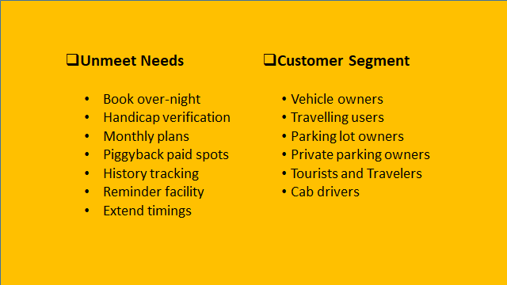
Notes:
Our app TMS lets users book their vehicle over-night, use monthly plans fix a parking spot, provide piggyback riding for other users as well as for themselves.
The target customer segment in this problem are the common people and drivers who are eligible for driving in United States or any other countries that have similar parking system and face issues of parking within the neighbourhood. Our app is for vehicle users who needs to park his vehicle in the neighbourhood, cab drivers who are waiting to get customer request, tourists and travllers who might need a parking spot for their rented cars.
shubham

Slide 3
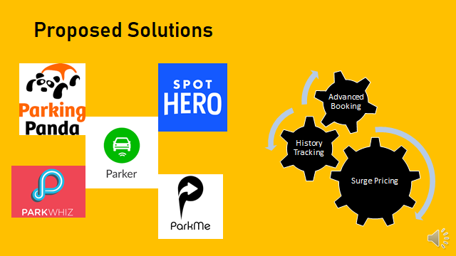
Notes:
shubham
Advanced booking: Although most of the existing apps provide an option to book a parking spot, they don’t provide the option to book it in advance at a cheaper price.
History tracking: tracking previously parked spots
Surge pricing: The existing apps provide inaccurate pricing for the parking spots when there are price surges, say if an event is going on.

Slide 4
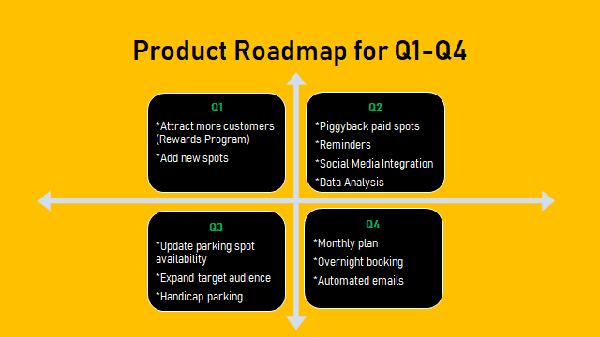

Slide 5
Key Metrics
Number of new registrations per month
Number of parking space bookings done by existing and new customers in any given month
Retention rate

Slide 6
VISUAL Storyboard (highlight one use case)

Slide 7
Product Features
Search for a spot
(Navigation)
Search for a spot
(Navigation)
Enabling user to opt for piggy backing spot from users who have vacated earlier
Notes:
Thank you-- The important product features for that’s my spot would be to provide a very intuitive and interactive UI for our application that would make it easy for accessing it across platforms be it website or mobile application.
The next feature would be finding a parking spot on street or say parking garages at any given time and also book it ahead of reaching the spot
The most unique part of Thats my Spot would be reserving parking spot on a monthly basis and renewing it as well
The application would also remind the user when their booking time is about to expire so that they can either renew it or reach on time to move their vehicle to avoud a parking ticket
Another extraordinary feature of That;s my spot is providing user the option of piggybacking their spot from users who have left early and marked their spot to be available for others

Slide 8
Features of MVP Launch
Search for a spot
(Navigation)
Book a Spot
(Booking)
Payment system
Notes:
before we get on to our MVP, let us see what MVP is-
MVP or Minimum Viable Product is the first working version of a product, with just enough features to satisfy potential clients and collect & analyze their feedback for the next product version, with minimum effort and resources required.
For our application, our first working version must have the ability to search for a spot, given current location of user and location where the user wants to book a spot.
Our application should also be able book a spot once the user has chosen the spot.
It should also have the ability to accept payments. The application should make sure that it is atomic, consistent, isolated and durable while processing the payments.

Slide 9
Operational Needs
Customer Survey Team: Gets feedback and review of the product based on rating, review from online platforms
Customer Survey Team: Gets feedback and review of the product based on rating, review from online platforms
License Info Verification: Collaborate with DMVs and police department to verify the license plate information
Parking Garage: Partner with garage owners to get latest update about parking spots - maintenance, new spots
Parking Meters: Collaborate with police department to get update about latest street parking and meters
Legal Advice: Third party legal team to provide advice on privacy protection act for license plate information
User update parking info: Update from users regarding the availability for a parking spot when vacating earlier
Notes:
The operational needs to be kept in mind for continuous improvement of That’s my spot are
the customer survey team getting feedbac from users by analysing the rating and also reviews posted on online platforms
Collaborating with DMVs and police dept to verify the license plate information to get valid information
Parking garage owners have to be contacted to get information about the latest update on parking garage in case of maintenance or if new parking spots have been added in a garage
The police dept should be contacted to get latest info on new street parking spts and metered parking spots in any give area
The legal advice team also comes in to picture to adhere to the privacy protecttion act as we handle license plate information of users
Finally we would also need users help in situation where they have vacated the spot earlier so that it can be arked available for other usrs

Slide 10
Projected Costs
•Development cost per hour * Total time taken to develop = Total cost of development
•Total cost of development would be $30*650*3= $58500
•Amazon Web Server’s costs $29 per month
•Amazon cloud storage cost $0.022 / GB
•200GB storage per month
•The estimated cost to build a parking finder app will be in the range of $90,000 to $120,000
Notes:
The cost to develop That’s my spot app depends on mainly three segments-
Per hour rate of the developer, per hour rate of designer and the total time to build the app. We can get an approximate cost using the following formula.
Suppose charge is $30 per hour of the developer and total time taken to build the app is 650 hours and we need 3 such developers in a team then the total cost of development would be

Slide 11
Addressing Risks
Privacy
Misuse
Cost
Legal
Permission
Technical
Competitor
Notes:
Any startup is bound to have a few risks. It is important how we mitigate these risks.
Privacy: as We’re collecting user’s licence plate number, location information and credit card information. We should make sure we are transparent with the users on how their data is used by having a privacy policy for our users.
Misuse: Storing all of this data is a huge task and we should make sure it is stored in a secure place.
Cost: To avoid any cost based risk, It is important for us to research about the projected costs.
Legal: Any new startup may encounter legal issues. We should consider registering trademarks, copyrights or patents.
Permission: To be more transparent about user permissions, We should make sure we form a solid Terms of use for our users to accept so that they can use our application.
Technical: Technical risks can occur anytime over the course of development. We should consider using the best algorithm and platforms.
It is also very important to test our product.
Competitor: While developing an application, it is natural to have other competitors. We have to keep an eye on other similar startups and do things uniquely. we should also Do our research very well and Focus on what we can control.

